Slide 1



Career Accelerator
Introduction to Financial Literacy, Capability and Inclusion

Slide 2


Housekeeping
Start time, break time, finish time
Participant Workbook
Ask questions, make comments
Communicate respectfully even if you disagree

Slide 3

Learning Outcomes
At the end of this workshop you will be able to:
1.
Define financial literacy, capability, and inclusion.
2.
Select a financial institution that meets your needs.
3.
Interpret your pay statement.

Slide 4
Learning Outcomes
At the end of this workshop you will be able to:
4.
Analyze your expenses vs your income.
5.
Create a personal budget.
6.
Understand savings and saving account options.

Slide 5

Workshop Agenda
1.
Talking about Personal Finances
2.
Financial Literacy, Capability and Inclusion
3.
Accessing Inclusive Financial Services
4.
Interpreting your Pay Statement
5.
Cash Flow and Budgeting
6.
Saving
7.
Review and Wrap Up

Slide 6


Talking about Personal Finances!

Slide 7

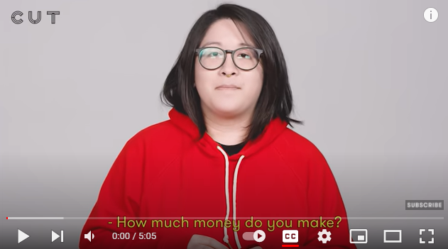

VIDEO:
100 People Tell Us How Much Money They Make
DIRECT LINK:
https://www.youtube.com/watch?v=a79PPZ_4abA

Slide 8




Financial Literacy
Financial Capability
Financial Inclusion
refers to possessing the skills and knowledge on financial matters to confidently take effective action that best fulfills an individual’s personal, family, and community goals. Source: National Financial Educators Council
is the combination of attitude, knowledge, skills, and self-efficacy needed to make and exercise money management decisions that best fit the circumstances of one’s life, within an enabling environment that includes, but is not limited to, access to appropriate financial services.
is the availability and equality of opportunities to access financial services. It refers to a process by which individuals and businesses can access appropriate, affordable, and timely financial products and services. These include banking, loan, equity, and insurance products. Source: World Bank Group

Slide 9






Character Introductions!
We will be reflecting on these individuals' financial knowledge, experience and needs throughout the duration of this workshop.
Amir
Zain
Jonathan
Sam & Jaz
Miigwan
Gabby

Slide 10
What Type of Support do they Need?
Do these individuals need support with their financial literacy or capability, or could they benefit from inclusive financial services?
Amir
Zain
Jonathan
Sam & Jaz
Miigwan
Gabby

Slide 11

Evaluating YOUR Financial Capability

Slide 12



Accessing Inclusive Financial Services
69% of Adults have bank accounts worldwide
1.7 billion people still
don’t have an account
99% of Canadians have an account

Slide 13







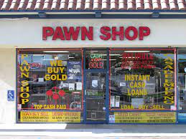













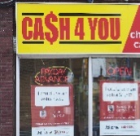






Financial Institutions in Canada
BANK
CREDIT UNION
ALTERNATIVE FINANCIAL INSTITUTIONS

Slide 14

Which Financial Institution is Right
for Me?
Things to Consider…
Fees
Interest Rates
Range of Products
Account Management Preferences

Slide 15
Interpreting your Pay Statement with these
Key Terms
Pay Period
Gross Pay
Wage
Net Pay

Slide 16
Payroll Deductions
Fed.
Income
Tax
Prov.
Income
Tax
CPP
EI

Slide 17

GUPTA, SAM Employee # 0019 Department # 80 Period Start 2022/02/06 Payday 2022/02/25 0013 00 Employer # O113-9 Period End 2022/02/20
STATEMENT OF EARNINGS EMPLOYEE DEDUCTIONS AND EMPLOYER CONTRIBUTIONS BULLETIN DE PAIE RETENUES DE L’EMPLOYE´ ET COTISATIONS PATRONALES
TYPE | HOURS HEURES | RATE TAUX | AMOUNT MONTANT | Y.T.D. A JOUR | TYPE | CURRENT COURANT | Y.T.D. A JOUR | TYPE | CURRENT COURANT | Y.T.D. A JOUR
REG HRS | 20.00 | 20.000 | 400.00 | 400.00 | E.I. C.P.P. | 6.32 14.46 | 6.32 14.46
1234999 ONTARIO INC
189 YONGE STREET TORONTO, ON M3R 1X7
Let’s take a look at Sam Gupta’s Pay Statement

Slide 18
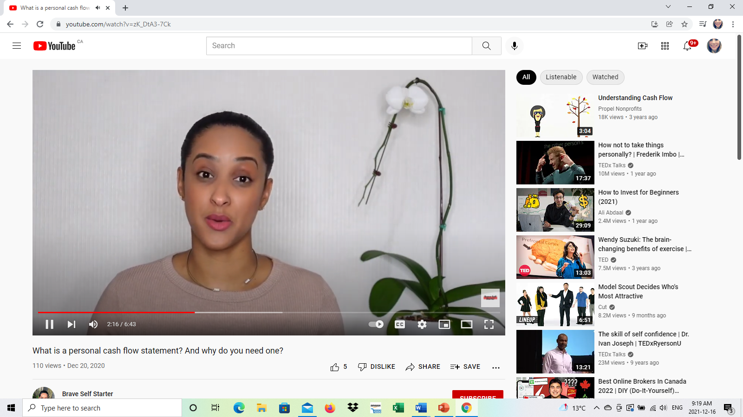
VIDEO:
What is a Cash Flow?
Your personal cash flow is measuring the movement of your money.
It is basically your income minus your expenses over a set period of time-typically a month
DIRECT LINK:
https://www.youtube.com/watch?v=zK_DtA3-7Ck

Slide 19

Budgeting
A budget is a plan that helps you manage your money. It helps you figure out how much money you earn, spend, and save. Making a budget can help you balance your income with your savings and expenses.
It guides your spending to help you reach your financial goals.

Slide 20
Budgeting
Budgeting will help you to track and manage your money and take note of what you spend.
If you track everything that you spend for a few months, it will become clear where you can save money. A key example of this would be, if you spend $3.00 on coffee every day, that alone will cost you almost $2000.00/ year, or more than $90.00/ month.
Needs | Wants

Slide 21
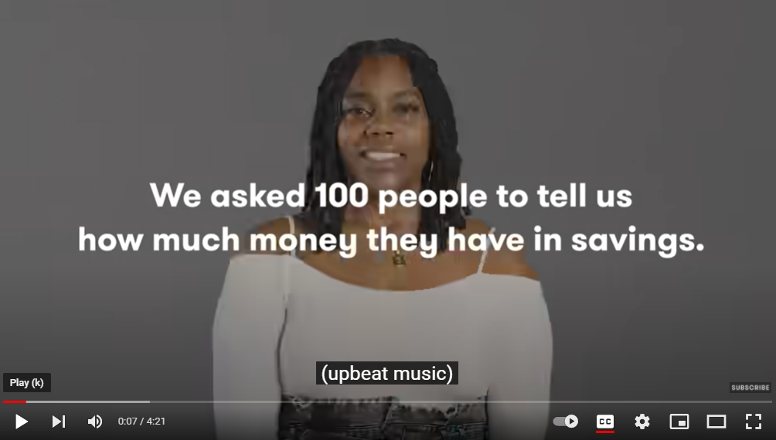
VIDEO:
100 People Reveal How Much Money They Have Saved
DIRECT LINK:
https://www.youtube.com/watch?v=Fqyxp-4TMZA&t=27s

Slide 22

Types of Savings Accounts
Basic Savings Account
Tax Free Savings Account
Registered Retirement Savings Plan (RRSP)
Youth Savings Account
High Interest Savings Account
Registered Education Savings Plan (RESP)
Registered Disability Savings Plan (RDSP)

Slide 23
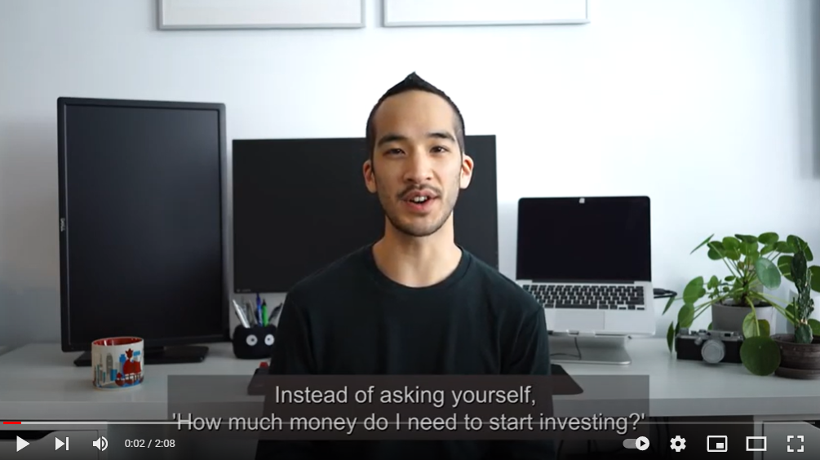
VIDEO:
When is it Time to Stop Saving and Start Investing?
DIRECT LINK:
https://www.youtube.com/watch?v=AL9zx1aU1SI
Notes:
Screen the video: When it’s Time to Stop Saving and Start Investing
https://www.youtube.com/watch?v=AL9zx1aU1SI
What are the main ideas that you heard?

Slide 24


Your Financial Roadmap
S
Specific
M
Measurable
A
Achievable
R
Realistic
T
Time-framed

Slide 25


Final Self-Reflection
Are you making the most of your money??

Slide 26

Review and Wrap-up
Questions
Final Thoughts

