Slide 1
Career Accelerator
Financial Management for Young Adults

Slide 2
Housekeeping
Start time, break time, finish time
Participant Workbook
Ask questions, make comments
Communicate respectfully even if you disagree

Slide 3
Learning Outcomes
At the end of this workshop you will be able to:
1.
Comprehend credit: different types, how to apply for credit and to understand your credit score.
2.
Understand debt: know your options, including repayment, consolidation, and bankruptcy.

Slide 4
Learning Outcomes
At the end of this workshop you will be able to:
3.
Track personal documents needed to file your income taxes.
4.
File your income taxes.
5.
Optimize your online security and prevent fraud.

Slide 5
Workshop Agenda
1.
Introduction to Module
2.
What is Credit?
3.
Understanding Debt
4.
Filing your Income Taxes
5.
Online Security and Fraud Prevention
Final Questions
6.

Slide 6
Before we Begin!
Adult·ing
/əˈdəltiNG,ˈaˌdəltiNG/ noun
“The practice of behaving in a way characteristic of a responsible adult, especially the accomplishment of mundane but necessary tasks.” (Oxford Dictionary)

Slide 7
What is Credit?
Credit is the ability to borrow money or access goods or services with the understanding that you'll pay later. (Experian)
There are many different types of credit that are used for different services. Your ability to access credit is important for your financial future. It helps you to get things that you need now, such as loan for a car, or a student loan.

Slide 8
VIDEO:
What is Credit and Why is it Important?
DIRECT LINK:
https://youtu.be/Gxt5xRdD3bI

Slide 9
Types of Credit
Revolving Credit:
Revolving credit is credit that you can keep using after you pay it off. You can continue to make purchases with it if the balance stays under the credit limit. Examples of revolving credit could be a line of credit, or a credit card.

Slide 10
Types of Credit
Installment Loans:
A car loan is an example of an installment loan. Installment loans are a form of credit, where you owe a set amount to which you pay in installments. There is a set amount of money loaned to you for a specific purpose. Common examples of Installment Loans are student loans and car loans.

Slide 11
Credit Products
Payday Loan
Consumer Loan
Line of Credit
Overdraft Protection
Private Auto Financing
Student Loan
Credit Card
Deferred Payment Plan
Rent-to-own Contract
Mortgage
Secured Credit Card
High Risk or Approved Loan
Informal Loan

Slide 12
Key Credit Terms and Concepts
Annual Fee
Annual Percentage Rate
Credit
Bureau
Credit
Limit
Credit
Rating
Balance
Grace
Period
Introductory
Rate
Minimum Payment
Compound Interest
Interest Rate
Overdraft Protection

Slide 13
Applying for Credit
Limit your amount of credit applications
Pay your bills on time
Keep your debt to a minimum
Look at the disadvantages and advantages of the credit product
Weigh your personal advantages/disadvantages or pros/cons
Opportunities

Slide 14
Advantages
Convenience
Perks/ Rewards (cash advance, air miles etc.)
Build a good credit history
Purchase protection
Recordkeeping
Available in case of emergency
Beneficial when traveling/ a lot have the option to make purchases worldwide

Slide 15
Disadvantages
Temptation (to use $ you don’t really have)
Fees
Interest charges
Tricky short-term teaser rates
Potential for credit card fraud
Able to obtain multiple cards/ accrue more debt than is necessary/ needed
Depending on a variety of factors (interest, rate you repay etc.), you can pay back A LOT more than you borrowed

Slide 16
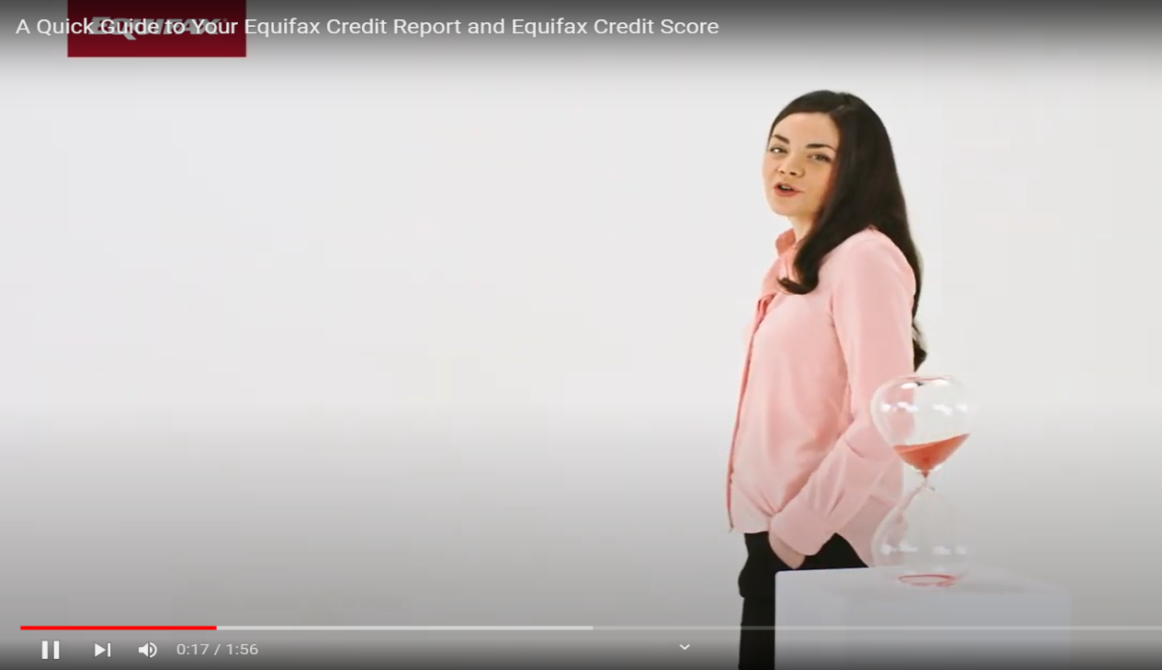
VIDEO:
A Quick Guide to your Equifax Credit Report and Equifax Credit Score
DIRECT LINK:
https://youtu.be/Nr2aK1k1_z4

Slide 17
Credit Reports and Scores
A credit report is a summary of your credit history. It is created when you borrow money or apply for credit for the first time. Lenders will send information about your accounts to credit reporting agencies, known as credit bureaus (ex. Equifax).
A credit score is a 3 digit number (ranging from 300 to 900) that comes from the information in your credit report. It shows how well you manage your credit (do you pay on time, pay your full balance, only make minimum payments etc.)

Slide 18
Factors that can Impact your Credit Score
If your bills are paid on time
If you carry a balance on your credit cards
How long you have had open accounts
Your number of credit applications, types of credit that you are using
Any records of insolvency or bankruptcy
If you are close to or above your credit limit

Slide 19
Interpreting your Credit Score
POOR
300-559
FAIR
560-659
GOOD
660-724
VERY GOOD
725-759
EXCELLENT
760-900

Slide 20
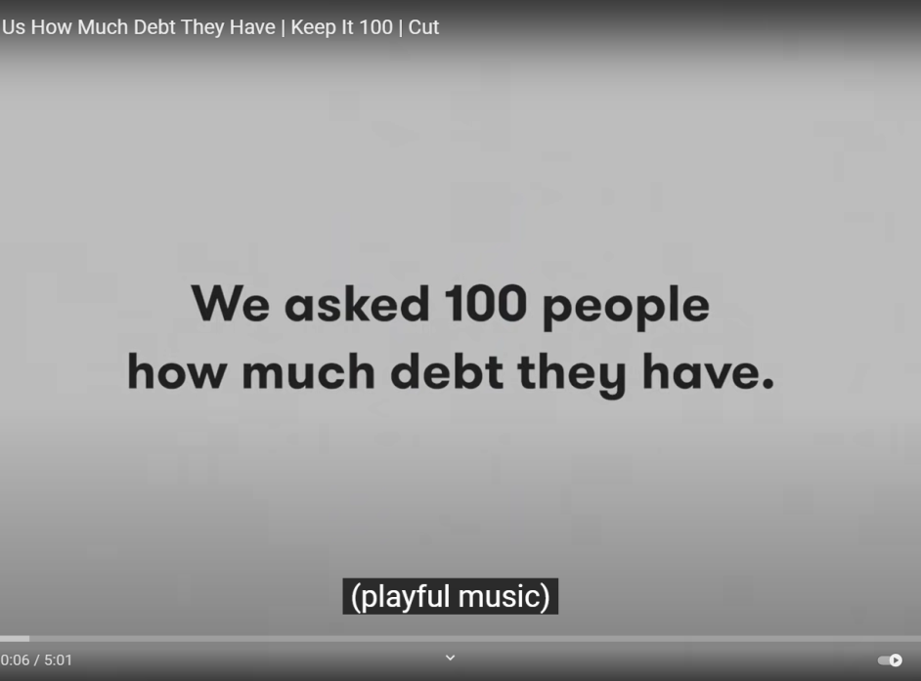
VIDEO:
We Asked 100 People How Much Debt They Have
DIRECT LINK:
https://www.youtube.com/watch?v=wAf0p9gP7oQ

Slide 21
Warning Signs that your Debt is getting out of Hand
You’re receiving calls from collections agencies due to missed payments
You’re regularly only making minimum payments
You’re being denied loan and credit approval because your credit score is poor
You’re relying on pay day loans or cash advances to cover every day or basic expenses/bills
You’re feeling stressed about your debt and it’s causing issues within your relationships

Slide 22
What are your options for dealing with debt?
REPAYMENT
DEBT
CONSOLIDATION
BANKRUPTCY

Slide 23
What is Income Tax?
Income tax refers to a type of tax that governments impose on income generated by businesses and individuals. By law, taxpayers must file an income tax return every year to determine their tax obligations.
Income taxes are a source of revenue for governments. They are used to fund public services, pay government obligations, and provide goods for citizens. (Investopedia.ca)

Slide 24
Steps to get ready for tax season: Let’s take a tour of the CRA website
DIRECT LINK:
https://www.canada.ca/en/services/taxes/income-tax/personal-income-tax/get-ready-taxes.html

Slide 25
What Do I Need to File?
Social Insurance Number (SIN)
Current address and phone number
T4 - employment income
T5007 - government social assistance
Records of other income
Receipts for tax deductions (ex. tuition paid, OSAP interest paid, medical expenses, charitable donations, public transit passes etc.)
CRA package with access code

Slide 26
Income Tax Benefits, Credits and Deductions
Trillium Drug Program
Low Income Workers Tax Credit
Ontario Staycation Tax Credit
Ontario Sales Tax Credit
GST/ HST Credit
Canada Workers Benefit
Disability Tax Credit
Canada Caregiver Credit
Charitable Donations
Ontario Electricity Support Program
Union Dues
Student Loan Interest
Tuition Paid
Canada Child Benefit
Ontario Child Care Tax Credit
Ontario Trillium Benefit

Slide 27
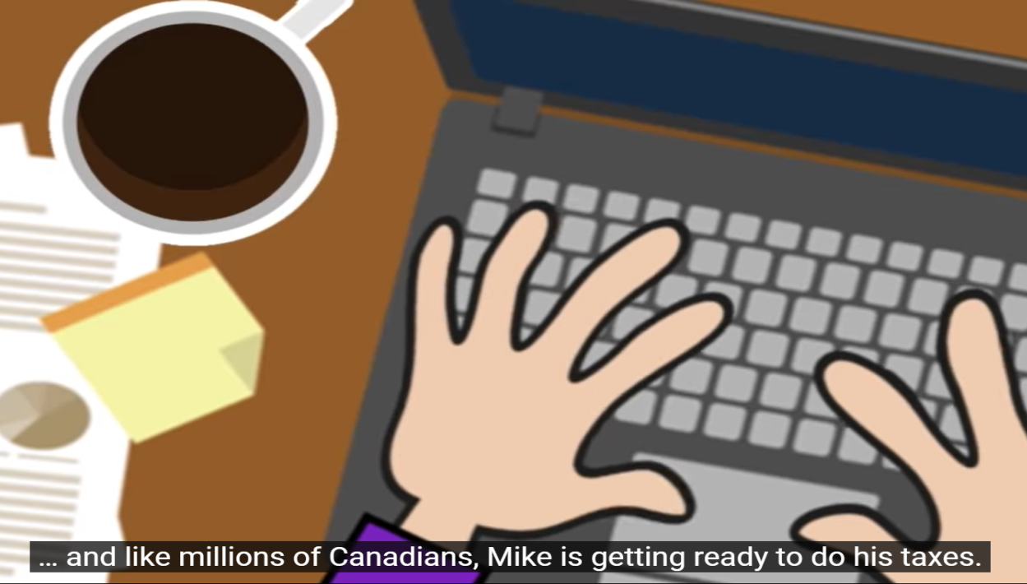
VIDEO:
Filing Online-Fast, Easy and Secure
DIRECT LINK:
https://www.youtube.com/watch?v=-HSjk7Wq3-U

Slide 28
What are your Options for Filing your Taxes?
Certified Tax Software
Authorize a representative
Community Volunteer Tax Clinics
Discounter
Paper tax return
Automated phone line (File My Return)
Tax Filing Assistance

Slide 29
What Happens After I File?
FILE TAX RETURN (ONLINE OR PAPER)
RECEIVE
NOTICE OF ASSESSMENT
RECIEVE REFUND OR PAYMENT REQUIRED

Slide 30
VIDEO:
How to Bank Safely Online
DIRECT LINK:
https://youtu.be/DGo-OhDWIKQ

Slide 31
Online Scams

Slide 32
Simple Steps to Protect Yourself and Prevent Fraud
Choose secure passwords
Protect your tablet, phone and computer
If something is not right, contact your creditor immediately
Never disclose your personal information

Slide 33
Final Self Reflection
How secure is my online presence??

Slide 34
Review and Wrap-up
Questions
Final Thoughts

