Slide 1
Entrepreneurship
101

Slide 2
Introductions
Instructor
Participants

Slide 3
Housekeeping
Start time, break time, finish time
Emergency exits, emergency protocols
Washrooms
Food and drink
Cell phone use

Slide 4
Workshop Materials
Participant Workbook
Digital device

Slide 5
Rules of Engagement
This workshop is for you.
Ask your questions.
Make your comments.
One person speaking at a time.
Communicate respectfully even when you disagree.
Have some fun along the way.

Slide 6
Learning Outcomes
At the end of this workshop you will be able to:
1.
Define entrepreneur.
2.
Discuss the importance of entrepreneurs in local and national economies.
3.
Notice entrepreneurs all around you.
4.
Identify the components of a model of entrepreneurship.

Slide 7
Learning Outcomes
At the end of this workshop you will be able to:
5.
Identify different types of enterprises.
Discuss the components of a model of entrepreneur: personal attributes/characteristics, background/ experience and skills/competencies of entrepreneurs.
6.
7.
Evaluate your own personal traits/characteristics, education/experience and skills/competencies.

Slide 8
1.
What is an Entrepreneur?
2.
Statistics on Entrepreneurs
3.
Entrepreneurs Around Us
4.
A Model for Entrepreneurship
Workshop Agenda
5.
Different Types of Enterprises
6.
A Model for Entrepreneurs

Slide 9
7.
Attributes/Characteristics of Entrepreneurs
8.
Experience/Background of Entrepreneurs
9.
Skills/Competencies of Entrepreneurs
10.
Your Entrepreneur Self-Evaluation
Workshop Agenda
11.
Review and Wrap-up
12.
Additional Resources

Slide 10
Based on these short videos, what is an entrepreneur?

Slide 11
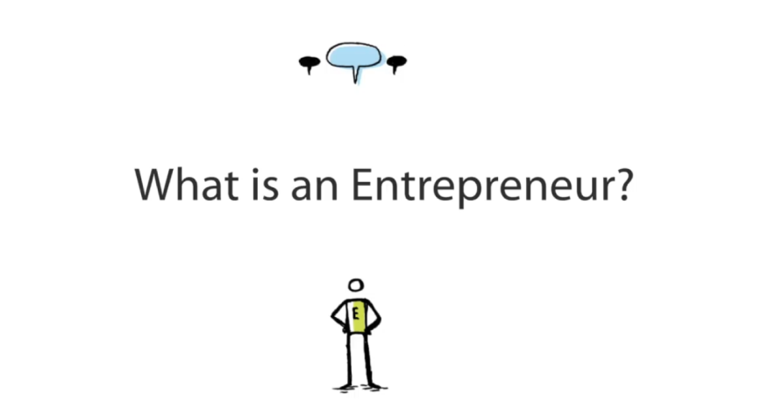
VIDEO:
Boys and Girls Club of Canada
DIRECT LINK:
https://www.youtube.com/watch?v=prDsSjywWag

Slide 12
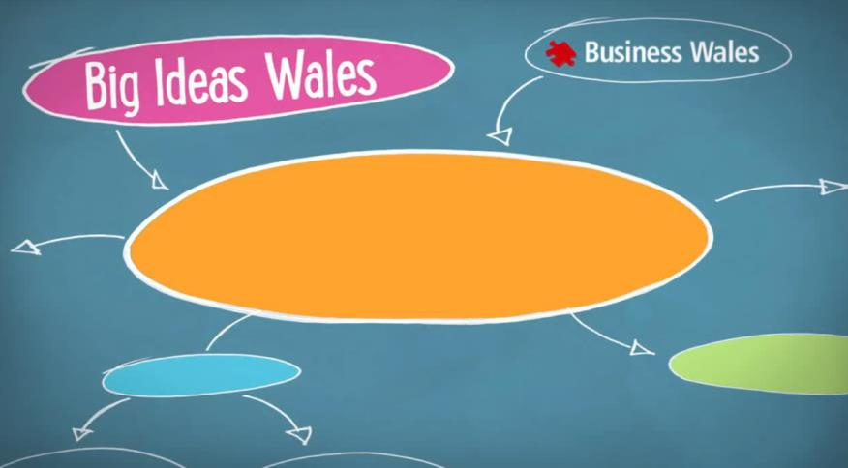
VIDEO:
Big Ideas Wales
DIRECT LINK:
https://www.youtube.com/watch?v=92ZmzD70sOU

Slide 13
What is an Entrepreneur?
Here are dictionary definitions of entrepreneur.
An entrepreneur is “a person who organizes and manages any enterprise, especially a business, usually with considerable initiative and risk.” Random House Dictionary
An entrepreneur is “the owner or manager of a business or enterprise who, by risk and initiative, attempts to make profits.” Collins English Dictionary

Slide 14
What is your definition of entrepreneur?

Slide 15
Look at each of the graphs from Statistics Canada, as well as at the red markings on the graphs. What does each graph tell us about running a small business in Canada?

Slide 16
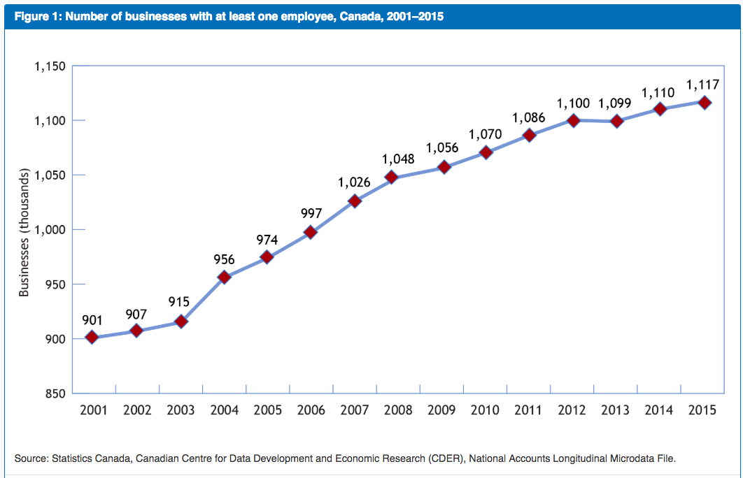
Statistics on Entrepreneurs
Number of Businesses 2001-2015

Slide 17
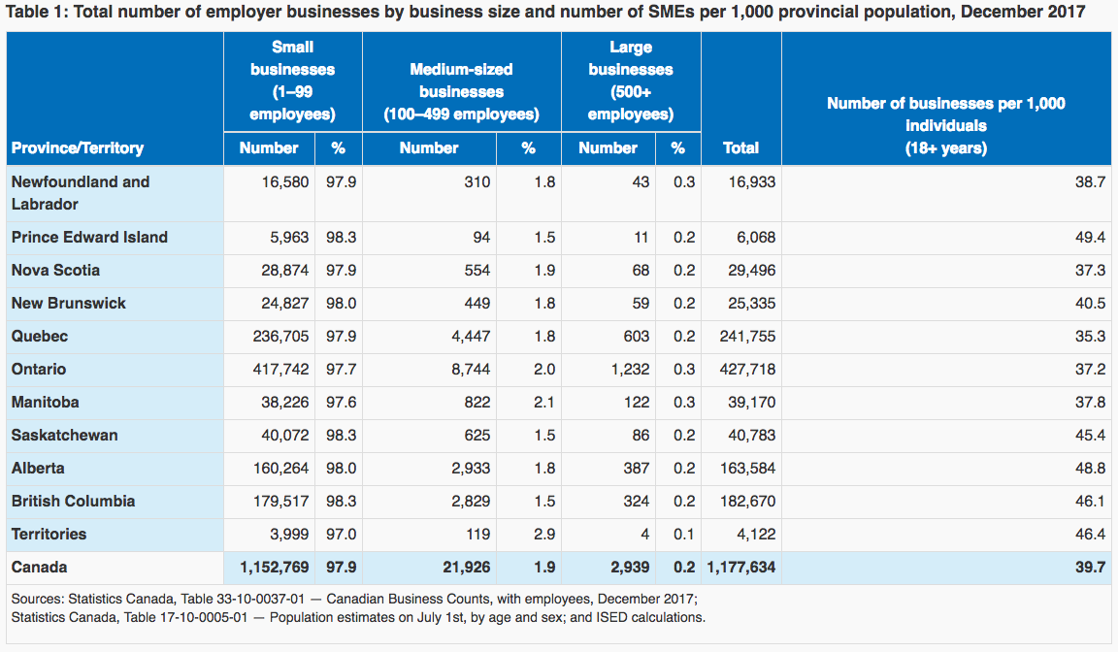
Statistics on Entrepreneurs
Number of Businesses by Size and Province 2017

Slide 18
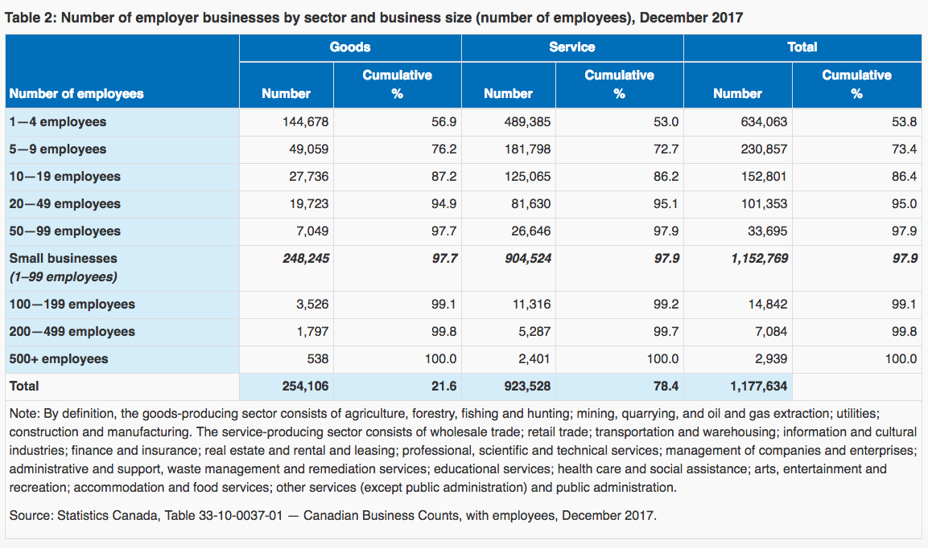
Statistics on Entrepreneurs
Number of Businesses by Size, Goods and Services 2017

Slide 19
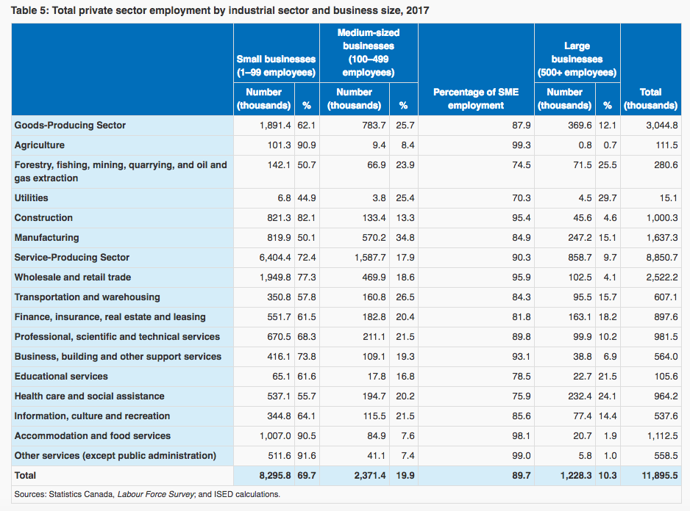
Statistics on Entrepreneurs
Number of Businesses by Size and Sector 2017

Slide 20
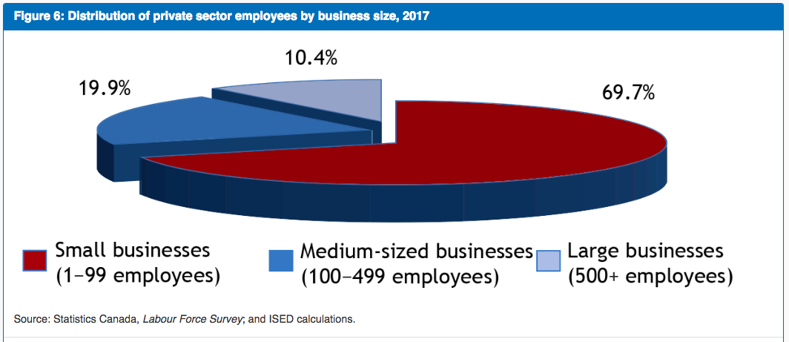
Statistics on Entrepreneurs
Percentage of Private Sector Employment by Size 2017

Slide 21
Statistics on Entrepreneurs
What do these statistics tell us about small businesses in Canada?
The number of small businesses, and therefore entrepreneurs, is steadily increasing.
Very small businesses (1-99 employees) represent the majority of businesses in all provinces.
Very small businesses (1-99 employees) represent the majority of businesses in both goods and services.

Slide 22
Statistics on Entrepreneurs
What do these statistics tell us about small businesses in Canada?
Very small businesses (1-99 employees) represent the majority of businesses in all sectors.
Very small businesses (1-99 employees) represent the majority of employment in the private sector.
Entrepreneurs are important to local, provincial and national economies.
Being an entrepreneur is a good career choice to consider and learn more about.

Slide 23
Where can we see entrepreneurs all around us every day?

Slide 24
Entrepreneurs Around Us

Slide 25
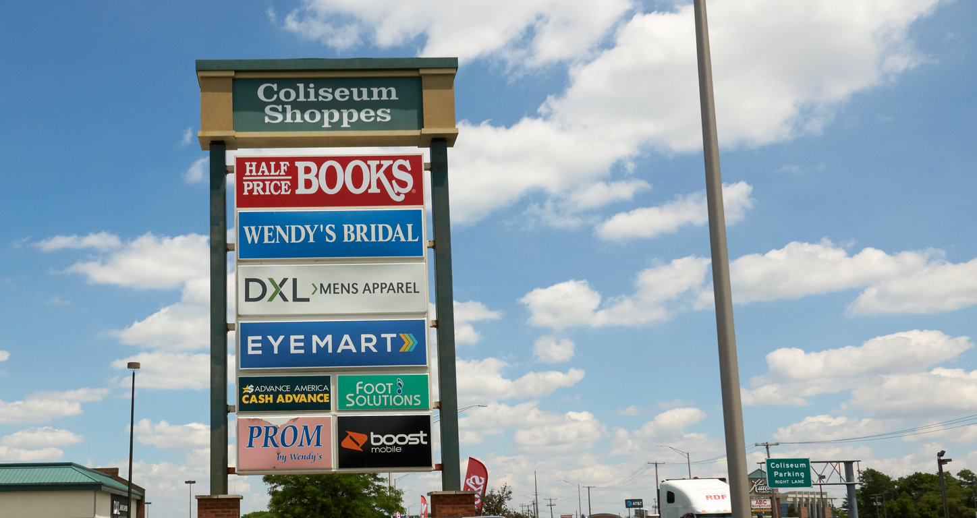
Entrepreneurs Around Us

Slide 26
Entrepreneurs Around Us

Slide 27
Entrepreneurs Around Us

Slide 28
Entrepreneurs Around Us

Slide 29
Do you know any entrepreneurs? If yes, what types of businesses have they built?

Slide 30
Watch one or more videos from the series How to Quit Your Job from the Canadian Federation of Independent Businesses (CFIB). Each video tells the story of a small Canadian entrepreneur. What did you learn from the story?

Slide 31
VIDEO:
Durham Custom Wood Décor
DIRECT LINK:
https://www.youtube.com/watch?v=EP3XfW0LPd0

Slide 32
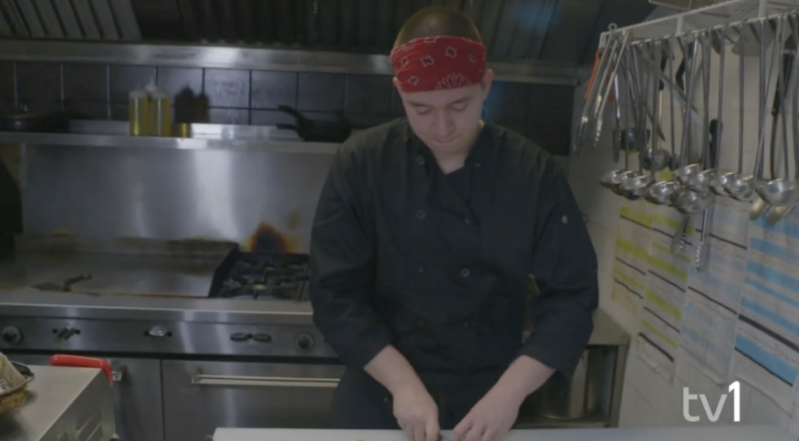
VIDEO:
FART Café
DIRECT LINK:
https://www.youtube.com/watch?v=WbTJvBqjcWE

Slide 33
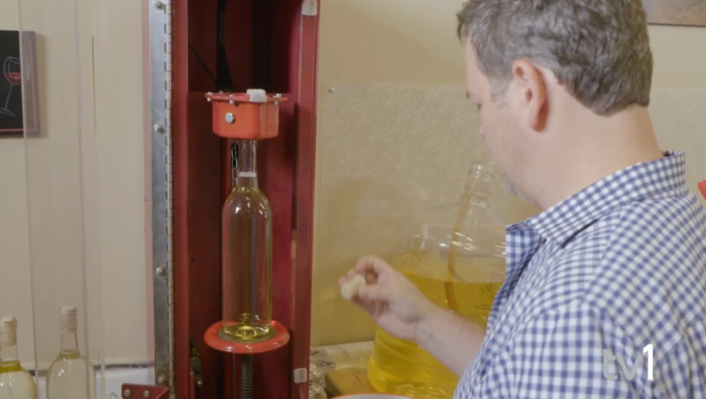
VIDEO:
Vezeau Wines
DIRECT LINK:
https://www.youtube.com/watch?v=d2BkJMprq5w

Slide 34
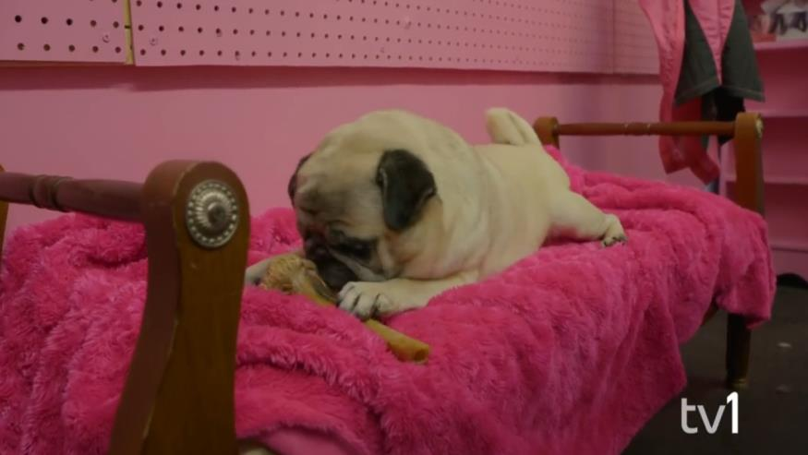
VIDEO:
Touch of a Paw Spa
DIRECT LINK:
https://www.youtube.com/watch?v=oRcK7EKdthw

Slide 35
VIDEO:
The Grid Family Entertainment Centre
DIRECT LINK:
https://www.youtube.com/watch?v=2e0_Tquiv4U

Slide 36
A Model of Entrepreneurship
4.1 Gartner’s (1985) Model of Entrepreneurship
Entrepreneur
Environment
Organization
Process

Slide 37
A Model for Entrepreneurship
Why is this model important for entrepreneurs?

Slide 38
A Model for Entrepreneurship
The success of an entrepreneur is not just about the entrepreneur.
It is also about the environment the entrepreneur is in, the processes the entrepreneur uses to build the business, and the organization the entrepreneur builds.
As entrepreneurs we have to look at all of these elements.
We will look at parts of these elements throughout the series of entrepreneurship workshops.

Slide 39
Different Types of Enterprises
There is a well-engrained public image of entrepreneurship as being about building world-changing, billion dollar, global enterprises. But the reality is that there are many different ways to be an entrepreneur and many different types of enterprises to build. Most of us won’t build global enterprises, but we will build enterprises that are meaningful and impactful for us, and that support us financially.

Slide 40
Put the names for the different types of enterprises given below next to the correct descriptions.

Slide 41
Different Types of Enterprises
The Side Hustle
This type of enterprise is run in addition to our regular job. We work on the business in the evenings or weekends. This is also known as a hobby enterprise, because it often starts as our hobby or something we are passionate about or good at. We then find that we can make money at it.

Slide 42
Different Types of Enterprises
The Microenterprise
This type of enterprise is very small. We work in the enterprise full time, however, there may just be us or two or three other people working in the business. The business brings in enough money for us to live on and we don’t really want it to get much bigger or more complicated.

Slide 43
Different Types of Enterprises
The Small Business
This type of enterprise grows a bit bigger, to have between 5 and 100 employees. We usually turn to friends and family to help us finance any growth in the business.

Slide 44
Different Types of Enterprises
The Scalable Enterprise
This is what we usually think of when we hear the word entrepreneurship. This is a start-up company that we think can be rapidly scaled up to dominate the market or create a new market. This is the type of enterprise that attracts venture capital and investors.

Slide 45
Different Types of Enterprises
The Social Enterprise
This type of enterprise creates products and services to solve social needs and problems. Our goal is to make the world a better place. While we need to make money to stay in business we are not driven by the thought of making a lot of money. This enterprise can be non-profit, profit or a combination of both.

Slide 46
Discuss with a partner which type of enterprise you are building and why.

Slide 47
A Model of Entrepreneurs
6.1 Ray’s (1993) Categories of Entrepreneurs Traits
Attributes/
Characteristics
Experience/
Background
Entrepreneurs
Opportunities
Skills/
Competencies

Slide 48
Why is this model important for entrepreneurs?

Slide 49
A Model for Entrepreneurs
The success of an entrepreneur is not just about attributes and characteristics (personality).
It is also about the entrepreneur’s background, experience and education, and the entrepreneur’s skills and competencies.
Parts of being an entrepreneur can be learned.
We will look at parts of all these throughout the series of entrepreneurship workshops.

Slide 50
Attributes/Characteristics of Entrepreneurs
7.1 Personal Attributes/Characteristics of Entrepreneurs from Entrepreneurs
Watch the videos
Note attributes/ characteristics of entrepreneurs the speakers mention

Slide 51
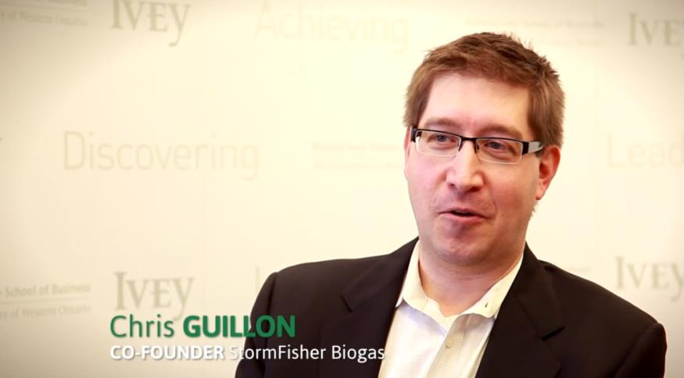
VIDEO:
Ivey 60 Second Entrepreneur: Chris Guillon
DIRECT LINK:
https://www.youtube.com/watch?time_continue=33&v=a5cMkmqU21g

Slide 52
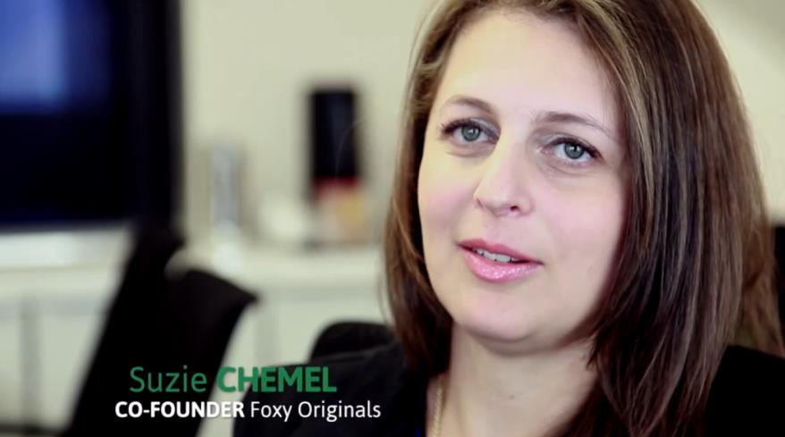
VIDEO:
Ivey 60 Second Entrepreneur: Suzie Chemel
DIRECT LINK:
https://www.youtube.com/watch?time_continue=62&v=nn9OQnVaMEQ

Slide 53
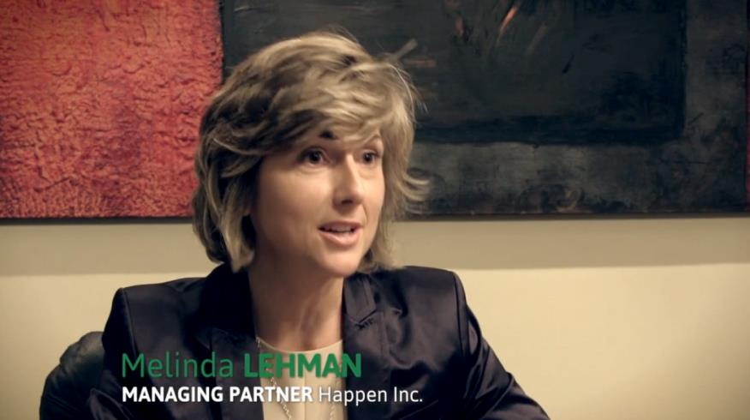
VIDEO:
Ivey 60 Second Entrepreneur: Melinda Lehman
DIRECT LINK:
https://www.youtube.com/watch?time_continue=60&v=bCeI1kfLllA

Slide 54
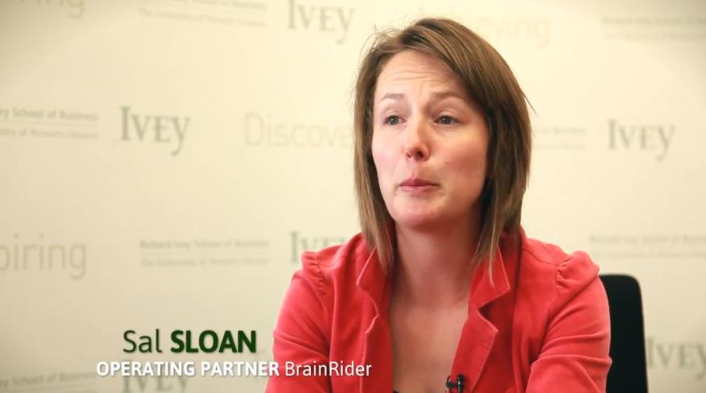
VIDEO:
Ivey 60 Second Entrepreneur: Sal Sloan
DIRECT LINK:
https://www.youtube.com/watch?time_continue=15&v=PYYZh4dQAjo

Slide 55
Read the article from MaRS Discovery District entitled Key Characteristics of Successful Entrepreneurs
What are more characteristics of entrepreneurs?
What are the Ten D’s of an Entrepreneur?

Slide 56
Attributes/Characteristics of Entrepreneurs
Characteristics of successful entrepreneurs are:
Entrepreneurs can identify opportunities.
They learn from their mistakes.
They like action or doing.
They know the hard work that it takes to succeed.
They have the physical and mental stamina for the hard work.
They ask for help when they need it or when they don’t have the expertise for something.

Slide 57
The Ten Ds of an entrepreneur are:
1.
Dream: They have a dream and they work to implement it.
2.
Decisiveness: They make decisions when needed.
3.
Doers: They take action.
Attributes/
Characteristics of Entrepreneurs
4.
Determination: They don’t give up.
5.
Dedication: They are dedicated to their business.

Slide 58
The Ten Ds of an entrepreneur are:
6.
Devotion: They love what they do.
7.
Details: They pay attention to details.
8.
Destiny: They are independent and take charge of their own lives.
Attributes/
Characteristics of Entrepreneurs
9.
Dollars: Money is not everything. It is a measure of success but it is not the end goal of a business.
10.
Distribute: They share ownership of their success with those employees who help get them there.

Slide 59
Attributes/Characteristics of Entrepreneurs
7.2 Personal Attributes/Characteristics of Entrepreneurs from Research
Internal Locus of Control
Need for Achievement
Comfortable with Risk
Initiative
Motivated
Self-Disciplined
Results-Oriented
Responsible
Creative
Perseverance
Self-Efficacy
Comfortable with Ambiguity
Comfortable with Uncertainty
Optimistic
Energetic
Flexible
Adaptable

Slide 60
Define the terms for attributes and characteristics of entrepreneurs.

Slide 61
Attributes/Characteristics of Entrepreneurs
Self-Efficacy: You believe in your ability to manage situations and resolve challenges.
Internal Locus of Control:
You look internally for the reasons for challenges and for solutions.

Slide 62
Attributes/Characteristics of Entrepreneurs
Comfortable with Risk: You don’t mind being in situations that may or may not have a positive outcome.
Comfortable with Uncertainty: You are comfortable when the outcomes of situations are not clear.
Comfortable with Ambiguity: You don’t mind being in situations that may or may not have a positive outcome.

Slide 63
Attributes/Characteristics of Entrepreneurs
7.3 Self-Evaluation of Your Personal Attributes/ Characteristics of Entrepreneurs
Use the self-evaluation tool in your Participant Workbook to analyze your own attributes and characteristics with respect to being an entrepreneur.
Provide a rating from 1 to 5 and also brief notes of evidence to support your rating.

Slide 64
Attributes/Characteristics of Entrepreneurs
7.4 Analyzing Your Strengths and Weaknesses
Like all people, we have some attributes and characteristics that are strengths and some that are weaknesses. We need to be aware of our weaknesses and balance them out with our experience, skills and competences and with the people we choose to work with.

Slide 65
Which of your attributes and characteristics could potentially negatively impact your entrepreneurship? How will you balance these weaknesses out?

Slide 66
Experience/ Background of Entrepreneurs
8.1 Analyzing Your Experience/Background
For each of the experience/background areas in the left hand column in the chart in your Participant Workbook identify how it aligns with your business idea.

Slide 67
Skills/Competencies of Entrepreneurs
9.1 Analyzing Your Skills/Competencies
Read the list of skills/competencies that might be necessary for entrepreneurship depending on the type of business you start and how large you grow it. Put a check mark over the skills/competencies that you feel are already strong. Circle the skills/competencies that you want to further develop. And put an X through the ones you don’t think you need for your type of business. Add other skills relevant to your business in the blanks.

Slide 68
9.2 Prioritizing Skills/Competencies to Learn
List all of the skills/competencies that you circled above that you need or want to learn in order of priority.

Slide 69
Entrepreneurial Potential Self-Assessment
Complete the online questionnaire from the Business Development Bank of Canada to assessment your overall entrepreneurial potential.
Do you agree with the results?
Why or why not?

Slide 70
1.
What is an Entrepreneur?
2.
Statistics on Entrepreneurs
3.
Entrepreneurs Around Us
4.
A Model of Entrepreneurship
5.
A Model of Entrepreneurs
6.
Personal Attributes/Characteristics of Entrepreneurs
Review & Wrap-Up
7.
Experience/Background of Entrepreneurs
8.
Skills/Competencies of Entrepreneurs
9.
Evaluating Your Entrepreneurship Potential

Slide 71
Review & Wrap-Up
Complete the concept checking quiz as a class

Slide 72
Review & Wrap-Up
Any final questions?

Slide 73
Additional Resources
For additional information on emotional intelligence for entrepreneurs, see the additional resource list in your Participant Workbook.

