Slide 1
Emotional Intelligence for Entrepreneurs

Slide 2
Introductions
Instructor
Participants

Slide 3
Housekeeping
Start time, break time, finish time
Emergency exits, emergency protocols
Washrooms
Food and drink
Cell phone use

Slide 4
Workshop Materials
Participant Workbook
Digital device

Slide 5
Rules of Engagement
This workshop is for you.
Ask your questions.
Make your comments.
One person speaking at a time.
Communicate respectfully even when you disagree.
Have some fun along the way.

Slide 6
Learning Outcomes
At the end of this workshop you will be able to:
1.
Understand emotional intelligence for entrepreneurs.
2.
Recognize the signs of stress and apply strategies for managing it.
3.
Identify the emotional challenges of risk, ambiguity, isolation, rejection, failure, and fear as an entrepreneur and apply strategies for managing them.

Slide 7
Learning Outcomes
At the end of this workshop you will be able to:
4.
Understand the importance of resilience, persistence, perseverance and grit for entrepreneurs.
5.
Identify and use strategies for building resilience, persistence, perseverance and grit, including emotional awareness, realistic optimism and whole person health.
6.
Identify the emotional challenges your entrepreneurial activities will present to you and the strategies that will help you manage these challenges.

Slide 8
1.
Emotional Intelligence for Entrepreneurs
2.
Stress
3.
Risk
4.
Ambiguity
5.
Isolation
Workshop Agenda
6.
Rejection
7.
Failure

Slide 9
8.
Fear
9.
Resilience
10.
Emotional Awareness
11.
Realistic Optimism
12.
Whole Person Health:
Mind, Body, Emotions, Spirit
Workshop Agenda
13.
Assess the Potential Emotional Challenges with Your Business
14.
Review and Wrap-Up

Slide 10
Emotional Intelligence for Entrepreneurs
1.1 What is Emotional Intelligence?
“
“
Emotional intelligence is the capacity to be aware of, control, and express one’s emotions to then handle interpersonal relationships judiciously and empathetically.
- Daniel Goleman

Slide 11
Emotional Intelligence for Entrepreneurs
Social Skills
Self-Awareness
Self-Regulation
Emotional Intelligence
Empathy
Motivation

Slide 12
Emotional Intelligence for Entrepreneurs
1.2 What are the Emotional Challenges of Entrepreneurs?
Watch the videos
What emotional challenges of entrepreneurs do the speakers share and discuss? What strategies do they suggest for managing these challenges?

Slide 13
VIDEO:
The Making of a Young Entrepreneur: Gabrielle Jordan Williams
DIRECT LINK:
https://www.youtube.com/watch?v=EblQj_pZFlQ

Slide 14
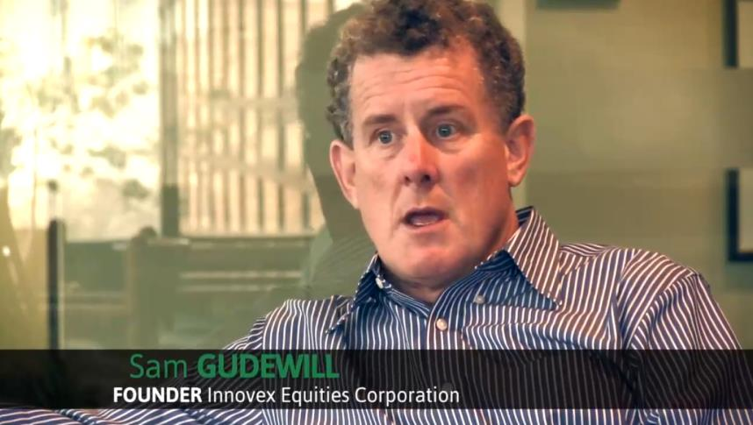
VIDEO:
60 Second Entrepreneur:
Sam Gudewill
DIRECT LINK:
https://www.youtube.com/watch?time_continue=55&v=DdjPK4cgQhs

Slide 15
VIDEO:
60 Second Entrepreneur: Andrew Barnicke
DIRECT LINK:
https://www.youtube.com/watch?time_continue=53&v=f_ev6788kAg

Slide 16
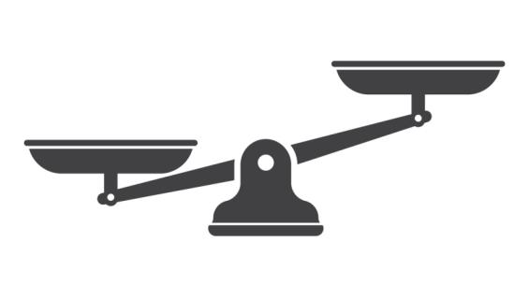
Emotional Intelligence for Entrepreneurs
1.3 What are the Emotional Balancing Act of Entrepreneurs?
Stress
Risk
Ambiguity
Isolation
Rejection
Failure
Fear
Resilience
Emotional Awareness
Realistic Optimism
Whole Person Health

Slide 17
\\\\\\\\\\\\\\\\\\
Stress
2.1 What is Stress?
Stress is mental or emotional tension that can result from new, challenging circumstances or events. In small amounts, stress can be productive.
It motivates us to take action and get work done. In large amounts, however, stress affects us emotionally, physically and mentally.
We feel excessive stress when we believe that we will not be able to manage the new circumstances or events.

Slide 18
\\\\\\\\\\\\\\\\\\
Stress
2.1 What is Stress?
Physical
Mental
Emotional

Slide 19
Stress
Stress manifests itself emotionally
Stress manifests itself physically
Anxiety, worry, frustration and anger.
Our emotions are negative, exaggerated, volatile and quick to change.
An elevated heart rate and blood pressure
Difficulty sleeping, and changes in appetite.

Slide 20
Stress
Stress manifests itself mentally
An inability to think clearly and focus.
A decrease in efficiency and effectiveness.

Slide 21
Stress
2.2 What Strategies Can We use for Managing the Stress of Being an Entrepreneur?
Important/ Can Control
Important/ Can’t Control
Unimportant/ Can Control
Unimportant/ Can’t Control
Realistic Locus of Control

Slide 22
Stress
Don’t “Awfulize”
Problem
Problem
Problem

Slide 23
Stress
Don’t React to Other People’s Stress
Others
You

Slide 24
Stress
Go for a Walk

Slide 25
Watch the video
Note down additional stress management strategies suggested by the speaker.

Slide 26
VIDEO:
How to Make Stress Your Friend by Kelly McGonical
DIRECT LINK:
https://www.youtube.com/watch?v=RcGyVTAoXEU

Slide 27
Risk
3. What is Risk?
Risk is the exposure to the chance of loss, danger or hazard.
As entrepreneurs we face risk every day:
Not getting paid by customers
Not finding financing
Changing regulations
Product or service risk
Random events

Slide 28
1.
Know the risks in your business.
2.
Have a plan for your business to eliminate, mitigate or manage each of these risks.
3.
Scan your environment for changes to the risk to your business.
4.
Continually gather information about your industry.
We have to manage risk strategically as an entrepreneur.
5.
Stay connected to others running similar businesses.
6.
Keep your skills current.

Slide 29
Risk
Where would you place yourself on the risk tolerance continuum below?
Very Comfortable with Risk
Very Uncomfortable with Risk

Slide 30
Ambiguity
4. What is Ambiguity?
Ambiguity is when we don’t have enough information or clarity in a situation in order to make a good decision, but we have to make a decision anyway.
This is the daily reality of entrepreneurs.
Every day we make decisions in ambiguous situations, without enough information.

Slide 31
1.
Know the areas of ambiguity in your business.
2.
Have a plan for your business to eliminate, mitigate or manage each of these areas of ambiguity.
3.
Continually gather information about your industry.
As with risk, we have to manage ambiguity strategically as an entrepreneur.
4.
Stay connected to others running similar businesses.
5.
Keep your skills current.

Slide 32
Ambiguity
Where would you place yourself on the ambiguity tolerance continuum below?
Very Comfortable with Ambiguity
Very Uncomfortable with Ambiguity

Slide 33
Isolation
5. How is it Isolating?
As entrepreneurs, all responsibility for the business stops with us.
Our staff, our friends and our family can support us to a certain extent, but they can’t share the experience of being ultimately responsible for everything in the business.
For this reason, being an entrepreneur can be very isolating.

Slide 34
Isolation
We need strategies to mitigate this isolation, otherwise it will significantly increase our stress level.
1.
Make the time to build and maintain a personal support network of friends and family.
2.
Build a team of business experts around you who can advise you on different aspects of your business.
3.
Join an entrepreneur network so that you can interact with other entrepreneurs.

Slide 35
What strategies can you use personally to decrease the amount of isolation you may have as an entrepreneur?

Slide 36
Rejection
6. How Does Rejection Fit in?
Running a business is about selling our products or services.
And selling involves being rejected and people saying “no”. Over and over and over.
As entrepreneurs, managing rejection is a crucial skill. If we can’t manage rejection, the stress of the repeated, and often not polite, “no’s” can paralyze us.

Slide 37
Watch the video
What strategies does the speaker recommend for managing rejection?

Slide 38
VIDEO:
What I Learned From 100 Days of Rejection by Jia Jiang
DIRECT LINK:
https://www.ted.com/talks/jia_jiang_what_i_learned_from_100_days_of_rejection

Slide 39
Failure
7.1 Business Failure
Perhaps the greatest possible stress that we entrepreneurs face is the possibility of the failure of our business or, the actual failure of our business.
Starting and running a business is risky and businesses fail all the time.
In Canada, only 80% of businesses survive for three years, only 60% survive for five years, and only 40% survive for ten years.

Slide 40
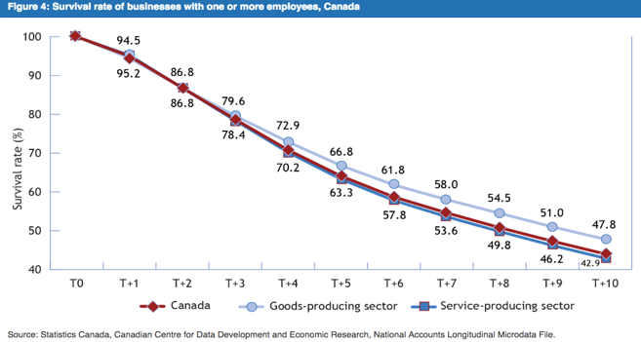
Failure

Slide 41
Lack of Skills
Lack of People Skills
Lack of Experience
Failure
Some of the reasons businesses fail lie directly with the entrepreneur:
Entrepreneur
Lack of Focus
Lack of Effort
Lack of Self-Awareness
Lack of Motivation

Slide 42
Lack of Planning
Low Quality Product or Service
Lack of Agility & Flexibility
Failure
And some of the reasons businesses fail lie with how the business is run or structured:
Entrepreneur
Not Competitive
Lack of Financing
Not Meeting Market Need
Poor Money Management

Slide 43
Failure
As entrepreneurs we actually fail regularly, on a daily basis, sometimes in large, spectacular ways and sometimes in small, insignificant ways.
We have to become comfortable with daily failure and view it as a way to learn, rather than as a source of stress.
7.2 Daily Failure
Failure is much more than the risk of our entire business failing.

Slide 44
Failure
Emotional Reaction
Action
Learning
Analysis

Slide 45
Failure
Emotional Reaction
Action
Think about a recent failure you had, large or small. Use the experiential learning process to the side to analyze what you learned from the failure.
Learning
Analysis

Slide 46
Fear
8. What is Fear?
Fear is an unpleasant emotion caused by our belief that someone or something is dangerous or a threat, and is likely to cause us pain or harm.
- Merriam-Webster Dictionary

Slide 47
Watch the video
What key ideas about fear does the speaker share? How do these ideas relate to you as an entrepreneur?

Slide 48
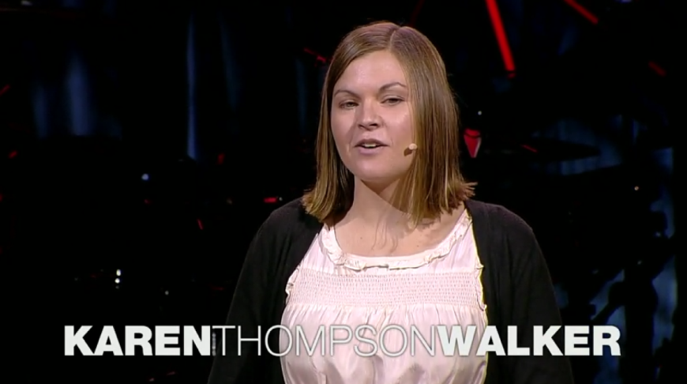
VIDEO:
What Fear Can Teach Us by Karen Thompson Walker
DIRECT LINK:
https://www.ted.com/talks/karen_thompson_walker_what_fear_can_teach_us

Slide 49
Resilience
9. What is Resilience?
Resilience is the ability to recover from a negative event.
Persistence is continuing our effort and not giving up.
Perseverance is continuing our effort regardless of difficulties or obstacles we face.
Grit is courage, resolve and strength of character.

Slide 50
Watch the video
What does the speaker say about the reasons for success? How does this apply to you as an entrepreneur?

Slide 51
VIDEO:
Grit: The Power of Passion and Perseverance by Angela Lee Duckworth
DIRECT LINK:
https://www.ted.com/talks/angela_lee_duckworth_grit_the_power_of_passion_and_perseverance

Slide 52
1.
Use your personal relationships with family and friends for emotional support.
2.
Keep things in perspective. Don’t exaggerate negative events or emotions.
3.
Accept that challenges, negative events and negative emotions are part of life.
4.
Have clear goals for your business and yourself, and keep these goals in mind all the time.
We have to manage risk strategically as an entrepreneur.
5.
Take action rather than procrastinating hoping that challenges will go away.
6.
Maintain a positive view of yourself and trust your abilities to manage challenges.

Slide 53
Emotional Awareness
10. What is Emotional Awareness?
The first step in building resilience is being aware of our emotions.
We all experience emotions differently. We have different triggers for emotions.
We also have different physical reactions when we feel the emotions, particularly negative emotions, for example sweating, nausea, or headaches.

Slide 54
Think about yourself emotionally. Select five negative emotions. Fill in the chart below with your triggers and physical reactions for those emotions.

Slide 55
Realistic Optimism
11. What is Realistic Optimism?
The most successful entrepreneurs practice realistic optimism.
Realistic optimism is when we are aware of the reality of a situation, particularly the challenges that exist, but we are also optimistic we have the strategies and skills to manage them.
We are both realistic about our situation and confident that we can navigate it.

Slide 56
Realistic Optimism
Where are you on the continuum below? What can you do to move yourself towards realistic optimism?
Optimism
Realistic Optimism
Pessimism

Slide 57
Whole Person Health:
12. Mind, Body, Emotions and Spirit
Mind/ Intellect
Body
Healthy Entrepreneur
Emotions
Spirit

Slide 58
List at least five things that you can do on a regular basis to keep each of the four dimensions of your life healthy as an entrepreneur.

Slide 59
Assess the Potential Emotional Challenges with Your Business
What do you foresee as the emotional challenges you will have when running your business? What strategies will you use to manage these emotional challenges, based on the information presented in the module?
Complete the chart in your workbook.

Slide 60
1.
Emotional Intelligence for Entrepreneurs
2.
Stress
3.
Risk
4.
Ambiguity
5.
Isolation
Review & Wrap-Up
6.
Rejection
7.
Failure

Slide 61
8.
Fear
9.
Resilience
10.
Emotional Awareness
11.
Realistic Optimism
12.
Whole Person Health:
Mind, Body, Emotions, Spirit
Review & Wrap-Up
13.
Assess the Potential Emotional Challenges with Your Business
14.
Review and Wrap-Up

Slide 62
Review & Wrap-Up
Complete the concept checking quiz as a class

Slide 63
Review & Wrap-Up
Any final questions?

Slide 64
Additional Resources
For additional information on emotional intelligence for entrepreneurs, see the additional resource list in your Participant Workbook.

