Slide 1
Digital Literacy for Entrepreneurs

Slide 2
Introductions
Instructor
Participants

Slide 3
Housekeeping
Start time, break time, finish time
Emergency exits, emergency protocols
Washrooms
Food and drink
Cell phone use

Slide 4
Workshop Materials
Participant Workbook
Digital device

Slide 5
Rules of Engagement
This workshop is for you.
Ask your questions.
Make your comments.
One person speaking at a time.
Communicate respectfully even when you disagree.
Have some fun along the way.

Slide 6
Learning Outcomes
At the end of this workshop you will be able to:
Navigate the basic functions of Microsoft Word, Excel and PowerPoint
1.
2.
Create simple administrative documents in Microsoft Word
Create a simple spreadsheet in Microsoft Excel, which includes addition, subtraction and multiplication
3.
4.
Create a simple ten-slide presentation in Microsoft PowerPoint

Slide 7
1.
Understanding Digital Literacy
2.
What is Skills to Succeed?
3.
Required Modules
4.
How to Register
5.
Workshop Agenda
Things to Note
6.
Review and Wrap-Up

Slide 8
Understanding Digital Literacy
1.
What is digital literacy?
What skills are part of digital literacy?
What digital literacy skills do YOU need for the specific business you want to start?
What digital literacy skills do you have?
2.
3.
4.

Slide 9
Understanding Digital Literacy
The dictionary defines digital literacy as:
An umbrella term for “the knowledge necessary to take advantage of the digital age. People who are digital literate use all the technological advances of the 21st century to improve their education, finances, social life and careers.” YourDictionary
Competencies for digital literacy can be classified according to three main principles:
Use
Understand
Create

Slide 10
What is Skills to Succeed?
Online platform powered by Accenture
By the end of 2020, Accenture plans to equip more than 3 million people with the skills to get a job or build a business through our Skills to Succeed initiative
Over 100 courses and resources

Slide 11
What is Available
Financial Literacy
Digital Literacy
Excel,
Outlook,
Power Point
Career planning
Applying/Job Search
Resume and cover letter
Networking
Using social media professionally
Interviews
Communicating professionally
Diversity and cultural awareness
Problem solving
Work ethic
Self awareness
Teamwork
Time Management
Customer Service
Entrepreneurship
Software Engineering
IT Customer Support
Retail industry fundamentals

Slide 12
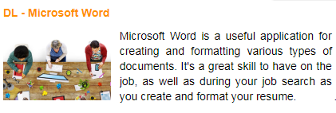
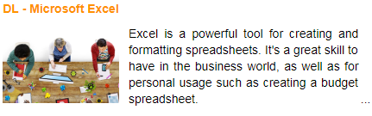
Required Modules
Select ‘Digital Literacy Enhanced’ under ‘Foundational Skills’
Complete the following modules:

Slide 13
http://www.yes.on.ca/online-workshops/
Existing YES clients: click on the following icon and make sure to select your program from the drop down menu
How to Register
All others: click on the following icon and select your organization from the drop down menu. If your organization is not listed select ‘YES Entrepreneurship Training’
* You must enable Cookies, JavaScript and PopUps for Skills to Succeed to work properly

Slide 14
Things to Note
Each module will tell you approximately how long it will take to complete in the course description
You can save your progress and pick up where you left off
Each module has an assessment at the end
Confirmation of completed courses can be found by clicking the ‘my certificate’ icon on the home page:

Slide 15
Wrap-Up
Feel free to browse the platform and select/ complete the resources and modules of your choice
Recommended Modules Include:
Customer Service Excellence
Business Communication Tools
Introduction to Business Meetings
Presentations
Professional Behaviours

