Slide 1
Creativity, Innovation and Opportunity Identification

Slide 2
Introductions
Instructor
Participants

Slide 3
Housekeeping
Start time, break time, finish time
Emergency exits, emergency protocols
Washrooms
Food and drink
Cell phone use

Slide 4
Workshop Materials
Participant Workbook
Digital device

Slide 5
Rules of Engagement
This workshop is for you.
Ask your questions.
Make your comments.
One person speaking at a time.
Communicate respectfully even when you disagree.
Have some fun along the way.

Slide 6
Learning Outcomes
At the end of this workshop you will be able to:
1.
Define creativity and understand the process of creating.
2.
Complete activities to help you develop your creativity.
3.
Define innovation and understand the process of innovation.

Slide 7
Learning Outcomes
At the end of this workshop you will be able to:
4.
Define opportunity identification and understand the process of opportunity identification.
5.
Complete activities to refine your opportunity identification skills.
6.
Analyze your own business idea through the lenses of creativity, innovation and opportunity identification.

Slide 8
1.
Creativity and Innovation Around Us
2.
What is Creativity?
3.
How do We Develop Our Creativity?
4.
Workshop Agenda
What is Innovation?
5.
How do We Develop Our Innovation Skills?

Slide 9
6.
What is Opportunity Identification?
7.
What is the Opportunity Identification Process?
8.
Refining Your Business Idea
Workshop Agenda
9.
Review and Wrap-Up

Slide 10
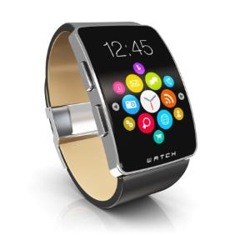
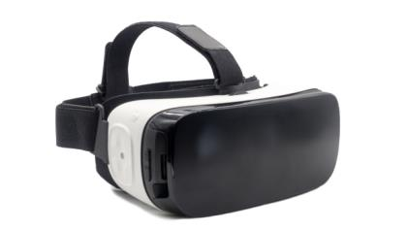
Creativity and Innovation Around Us

Slide 11
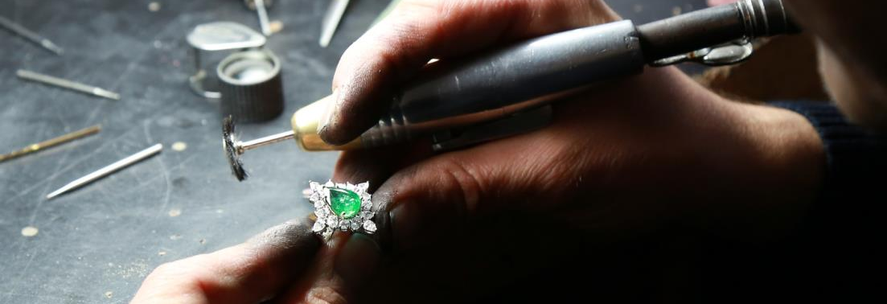
Creativity and Innovation Around Us

Slide 12
Creativity and Innovation Around Us

Slide 13
Creativity and Innovation Around Us

Slide 14
Creativity and Innovation Around Us

Slide 15
Creativity and Innovation Around Us

Slide 16
Creativity and Innovation Around Us
1.1 Noticing Creativity and Innovation
Think of at least five new products or services that you noticed recently. What was new about them? Why did you notice them?

Slide 17
What is Creativity?
Creativity leads to the development of something new and valuable.
Creativity results from the potential of the mind to conceive new ideas.
Building and running a business is a highly creative process.

Slide 18
What is Creativity?
2.1 Is Creativity an Ability or a Process?
Creativity is the ability to generate new ideas.

Slide 19
What is Creativity?
Knowledge and Information
Analytical
Skills
Critical Thinking Skills
Problem-Solving Skills
Observation Skills
Non-
Judgmental
Imagination
Curiosity
Intuition

Slide 20
What is Creativity?
2.1 Is Creativity an Ability or a Process?
Creativity is the process to generate new ideas.

Slide 21
What is Creativity?
Linear process?
A
B

Slide 22
What is Creativity?
Non-linear process?
A
B

Slide 23
What is Creativity?
An epiphany process?

Slide 24
What is Creativity?
A percolating process?

Slide 25
What is Creativity?
An incubation process?

Slide 26
Observation
Define Problem
What is Creativity?
Test
A circular process?
Decision
Ideate

Slide 27
How Do We Develop Our Creativity?
3.1 Playing With Lego
Take the bag of Lego pieces (or other building materials). Working in a small group, construct each of the following objects one at a time: a house, a tree, a car, a robot, a flower. Your instructor will give you different directions before you build each object.

Slide 28
Visually represent the emotion given by the instructor using your Lego pieces.

Slide 29
How Do We Develop Our Creativity?
3.2 Object Use Brainstorming
Take any object from your bag. What is it used for? With your group, brainstorm at least ten other uses for the object.

Slide 30
3.3 Object Improvement Brainstorming
Take any object from your bag. How can it be improved? With your group, brainstorm at least ten ways to make the object better.

Slide 31
What is Innovation?
4.1 What is Innovation?
Innovation is the implementation of ideas generated through creativity. Innovation is about making the ideas a reality and putting them to work. In addition to good ideas, we need the resources, processes and environment in which to implement them.

Slide 32
What is Innovation?
4.2 Frugal Innovation
Watch the video
What is frugal innovation? Why is it important?

Slide 33
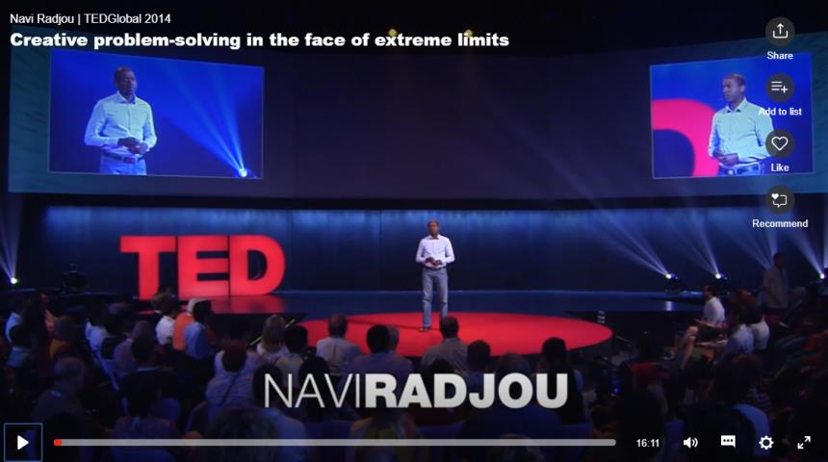
VIDEO:
Creative Problem-Solving the Face of Extreme Limits: Ravi Nadjou
DIRECT LINK:
https://www.ted.com/talks/navi_radjou_creative_problem_solving_in_the_face_of_extreme_limits

Slide 34
How Do We Develop Our Innovation Skills?
5.1 Becoming a Practical Idealist
In addition to developing our creativity, we need to be a practical idealist. We need to identify what we need to do in order to turn our idea into reality.

Slide 35
How Do We Develop Our Innovation Skills?
People
Other
Resources
Finances
Idea
Time
Technology

Slide 36
How Do We Develop Our Innovation Skills?
5.1 Becoming a Practical Idealist
Use the word map on the next page. Put your business idea in the middle. With a partner or small group, brainstorm everything you need in order to make your idea a reality, using the categories in the word map as a guide.

Slide 37
What is Opportunity Identification?
6.1 Types of New Opportunities
Products
Services
Processes
Organization systems
Markets/locations
Raw materials
Business models

Slide 38
Think of an example new opportunity for each type of opportunity listed on the previous slide.

Slide 39
What is Opportunity Identification?
6.2 Forces Creating New Opportunities
Political and Regulatory Change
Social and Demographic Change
Technological Change
Lifestyle Change
Opportunities

Slide 40
Complete the chart with possible new opportunities created by the types of changes given in the two left-hand columns.

Slide 41
What is Opportunity Identification?
Technological Change:
Online Market Places
Selling used goods
Selling handcrafted goods
Online payment systems
Warehousing and logistics systems

Slide 42
What is Opportunity Identification?
Political/Regulatory Change: Legalization of Marijuana
Cultivation of marijuana
Processing of marijuana
Manufacturing marijuana products
Selling marijuana
Testing devices for marijuana influence

Slide 43
What is Opportunity Identification?
Social/Demographic Change: Aging Population
Anti-aging products
In-home support and care services (cleaning, shopping, handyman, nursing, meal preparation)
Retirement complexes
Retirement travel

Slide 44
What is Opportunity Identification?
Lifestyle Change: Fast-Paced Lifestyle
Assistance with house hold chores (cleaning, repair, gardening, lawn care, snow plowing, pet walking)
Assistance with managing our lives (personal assistant, personal shopper, ready-made meals, grocery shopping)

Slide 45
What is Opportunity Identification?
6.3 Changes from New Technologies
Thinking back just over the past five to ten years, list at least five new technologies. Beside them, list at least one new business opportunity that resulted from the technology change.

Slide 46
What is Opportunity Identification?
6.4 Opportunity Identification as Solving Problems
Another way to think of opportunities is as problems that need to be solved.

Slide 47
For each of the opportunities given in the chart, what problem is being solved?

Slide 48
What is the Opportunity Identification Process?
7.1 An Opportunity Identification Diagram

Slide 49
What is the Opportunity Identification Process?
7.2 The Importance of Information and Knowledge
One thing that helps us identify opportunities is information.
It should be information that is current and cutting edge, that comes from different perspectives and from different fields.

Slide 50
What is the Opportunity Identification Process?
We can gain this information by reading, listening and watching quality information sources.
We can also gain this information from our social network. The larger and more informed our social network the more information we have access to.

Slide 51
Watch the video
What does the entrepreneur tell us about information/knowledge and opportunity identification?

Slide 52
VIDEO:
60 Second Entrepreneur: Comprehensive Understanding
DIRECT LINK:
https://www.youtube.com/watch?time_continue=33&v=SaRl2GrN-tA

Slide 53
What is the Opportunity Identification Process?
7.3 Identifying Easy and Practical Opportunities
Many opportunities are not expensive to turn into actual businesses. They do not require us to purchase very much equipment, property or inventory. They also don’t require us to follow a lot of regulations.

Slide 54
What is the Opportunity Identification Process?
Low Barriers to Entry
Low
Investment
Low
Regulation

Slide 55
Think of opportunities created by lifestyle changes, an aging population and/or technology changes that are easy and inexpensive to turn into businesses.

Slide 56
Refining Your Business Idea
Using everything you have learned about creativity, innovation and opportunity identification, work with a partner or small group to refine your business idea.

Slide 57
1.
Creativity and Innovation Around Us
2.
What is Creativity?
3.
How do We Develop Our Creativity?
4.
What is Innovation?
5.
How do We Develop our Innovation Skills?
6.
What is Opportunity Identification?
Review & Wrap-Up
7.
What is the Opportunity Identification Process?
8.
Refining Your Business Idea

Slide 58
Review & Wrap-Up
Complete the concept checking quiz as a class

Slide 59
Review & Wrap-Up
Any final questions?

Slide 60
Additional Resources
For additional information on emotional intelligence for entrepreneurs, see the additional resource list in your Participant Workbook.

